Slide 1
A Survey to Self-Supervised Learning
Naiyan Wang

Slide 2
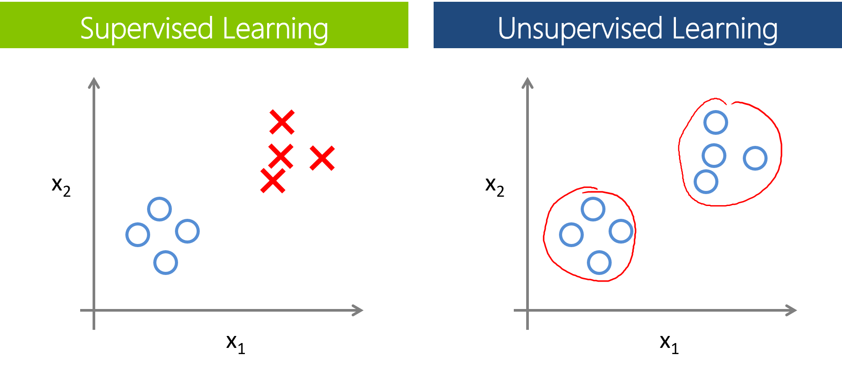
Paradigm of Learning
Supervised Learning & Unsupervised Learning
Given desired output vs. No guidance at all
http://oliviaklose.azurewebsites.net/content/images/2015/02/2-supervised-vs-unsupervised-1.png

Slide 3
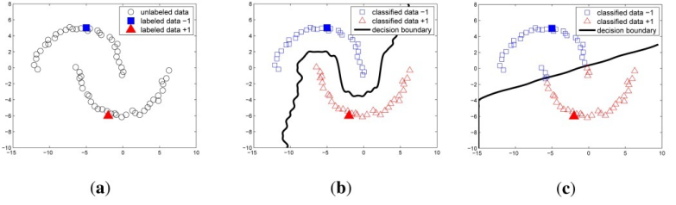
Paradigm of Learning
In Between…
Semi-Supervised Learning
Mix labeled and unlabeled data
https://openi.nlm.nih.gov/imgs/512/371/4299091/PMC4299091_sensors-14-23871f4.png

Slide 4
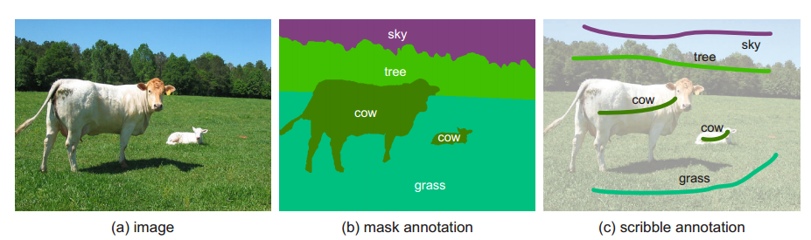
Paradigm of Learning
In Between…
Weakly-Supervised Learning
Use somewhat coarse or inaccurate supervision, e.g.
Given image level label, infer object level bounding box/ pixel level segmentation
Given video level label, infer image level label
Given scribble, infer the full pixel level segmentation
Given bounding box, infer the boundary of object
Lin, D., Dai, J., Jia, J., He, K., & Sun, J. (2016). Scribblesup: Scribble-supervised convolutional networks for semantic segmentation. In CVPR2016.

Slide 5
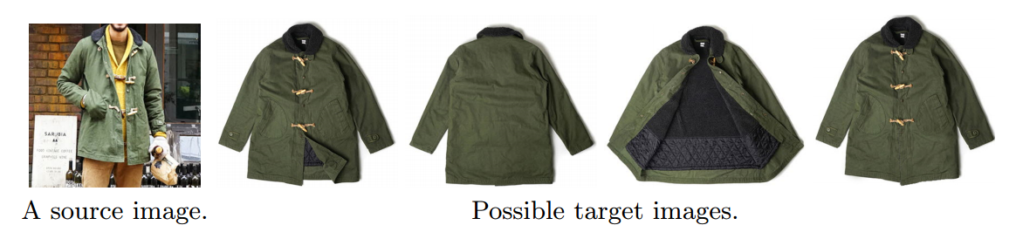
Paradigm of Learning
In Between…
Transfer Learning
Train on one problem, but test on a different but related problem, e.g.
Multi-Task learning
Train on one domain, test on another domain (possibly unlabeled)
Yoo, D., Kim, N., Park, S., Paek, A. S., & Kweon, I. S. (2016, October). Pixel-level domain transfer. In ECCV2016

Slide 6
Paradigm of Learning
More to mention…
Reinforcement Learning
Active Learning
Zero/One/Few-Shot Learning

Slide 7
Self-Supervised (Feature) Learning
What is it?
Use naturally existed supervision signals for training.
(Almost) no human intervention
Why do we need it?
The age of “representation learning”! (Pre-training – Fine-tune pipeline)
Self-Supervised learning can leverage self-labels for representation learning.
How can we realize it?
That is in this talk!

Slide 8
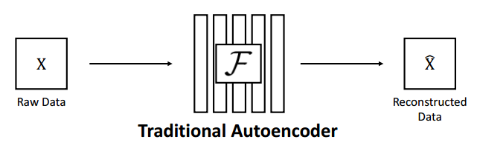
Why not use construction?
What is wrong with autoencoder?
Use pixel-wise loss, no structural loss incorporated
Reconstruction can hardly represent semantic information
GAN may alleviate the first issue (e.g. BiGAN)

Slide 9
Outline
Context
Video
Cross-Modality
Exemplar Learning

Slide 10
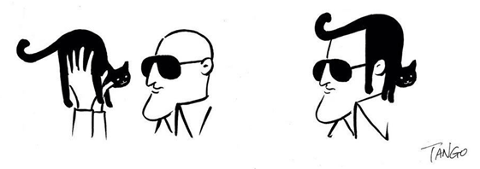
Context
Context is ubiquitous in CV/NLP
管中窥豹 & 断章取义
Cat or hair?
Beyond using it to improve performance, can you use it as supervision directly?

Slide 11
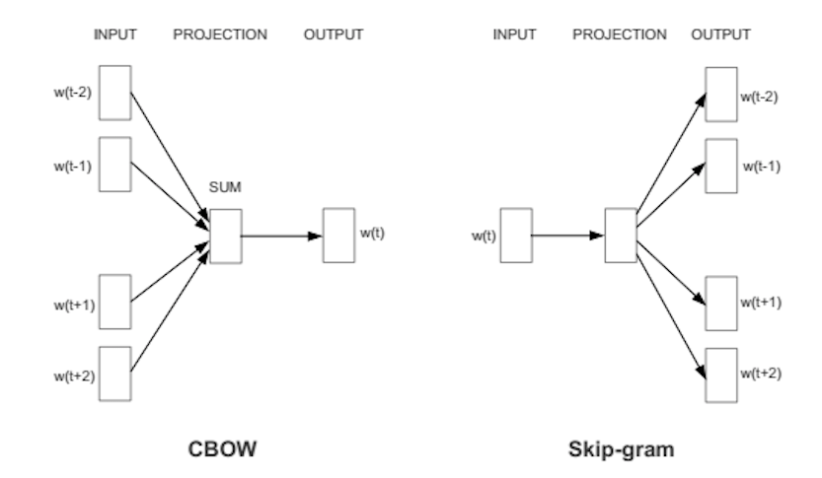
Context
Word2Vec: 1-dim context in NLP
https://deeplearning4j.org/img/word2vec_diagrams.png

Slide 12
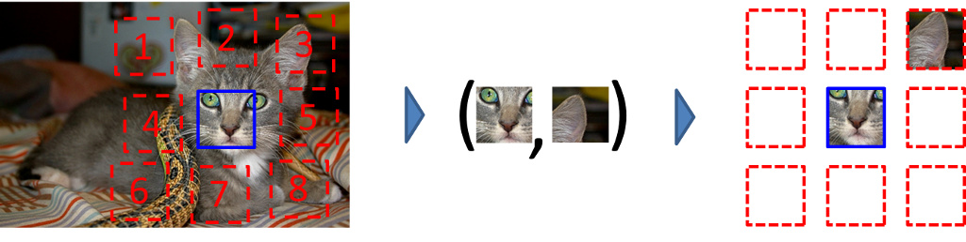
Context
Solving the Jigsaw
Predict relative positions of patches
You have to understand the object to solve this problem!
Be aware of trivial solution! CNN is especially good at it
Carl Doersch, Abhinav Gupta, and Alexei A. Efros. Unsupervised Visual Representation Learning by Context Prediction. In ICCV 2015

Slide 13
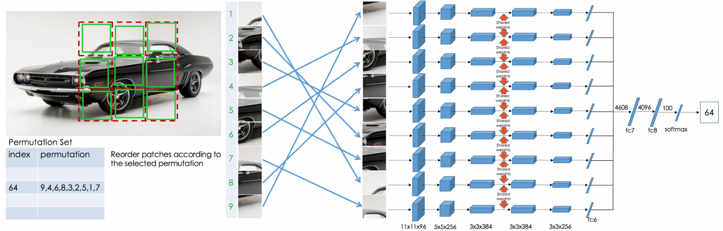
Context
Solving the Jigsaw
Use stronger supervision, solve the real jigsaw problem
Harder problem, better performance
Noroozi, M., & Favaro, P. Unsupervised learning of visual representations by solving jigsaw puzzles. In ECCV 2016.

Slide 14
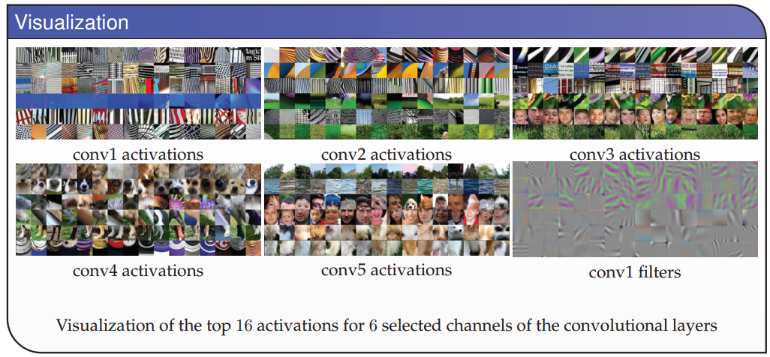
Context
Solving the Jigsaw
Visualization of filters
Noroozi, M., & Favaro, P. Unsupervised learning of visual representations by solving jigsaw puzzles. In ECCV 2016.

Slide 15
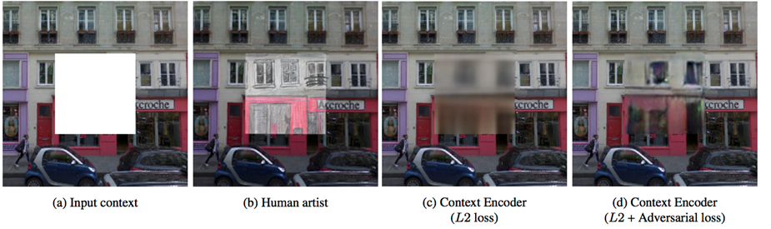
Context
Why not directly predict the missing parts?
With the advancement of adversarial loss
Deepak Pathak, Philipp Krahenbuhl, Jeff Donahue, Trevor Darrell and Alexei A. Efros. Context Encoders: Feature Learning by Inpainting. In CVPR 2016.

Slide 16
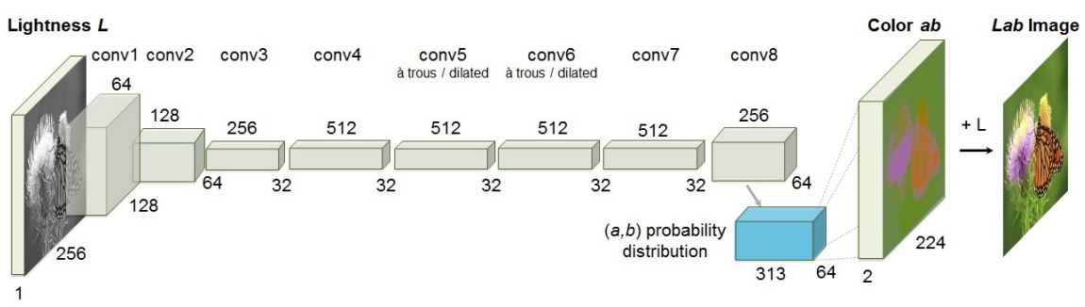
Context
Colorization
You have to know what the object is before you predict its color
E.g. Apple is red/green, sky is blue, etc.
Zhang, R., Isola, P., & Efros, A. A. Colorful image colorization. In ECCV 2016

Slide 17
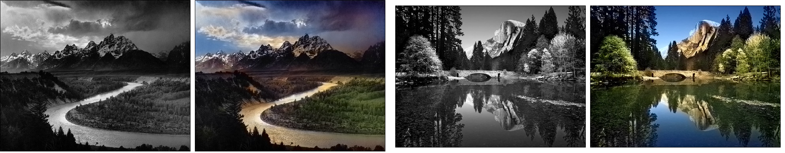
Context
Colorization
It is important how to interpret your work!
Example colorization of Ansel Adams’s B&W photos
Zhang, R., Isola, P., & Efros, A. A. Colorful image colorization. In ECCV 2016

Slide 18
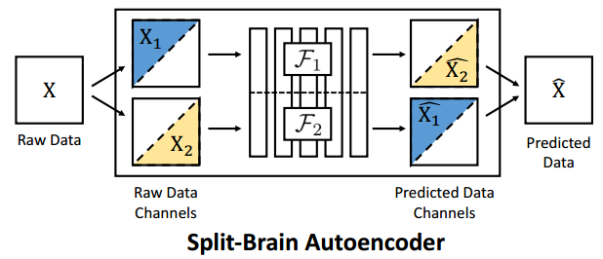
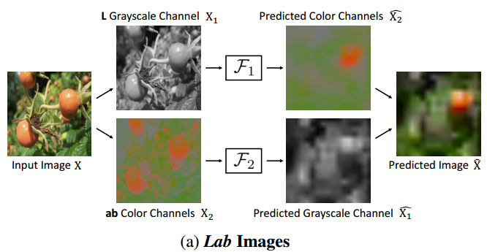
Context
Colorization
Stronger supervision, cross-supervision of different parts of data
Zhang, R., Isola, P., & Efros, A. A. Split-Brain Autoencoders: Unsupervised Learning by Cross-Channel Prediction. In CVPR 2017

Slide 19
Video
Video can provide rich information
Temporal continuity
Motion consistency
Action order

Slide 20

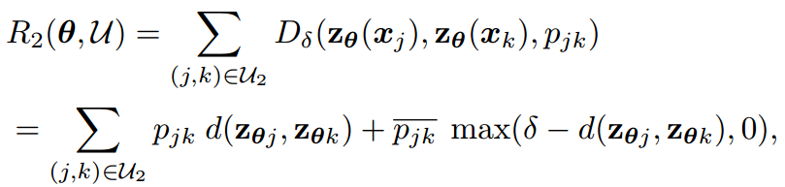
Video
Slow feature
Neighborhood frames should have similar features
Mobahi, H., Collobert, R., & Weston, J. Deep learning from temporal coherence in video. In ICML 2009.
Wiskott, L., & Sejnowski, T. J. (2002). Slow feature analysis: Unsupervised learning of invariances. Neural computation, 14(4), 715-770.

Slide 21
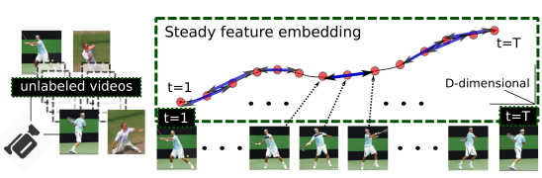

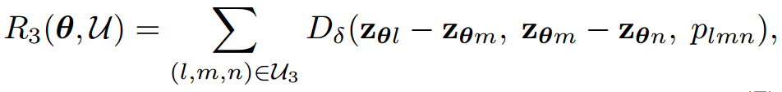
Video
Slow and steady feature
Not only similar, but also smooth
Extend to triplet setting (Not triplet loss!)
Jayaraman, D., & Grauman, K. Slow and steady feature analysis: higher order temporal coherence in video. In CVPR 2016.

Slide 22
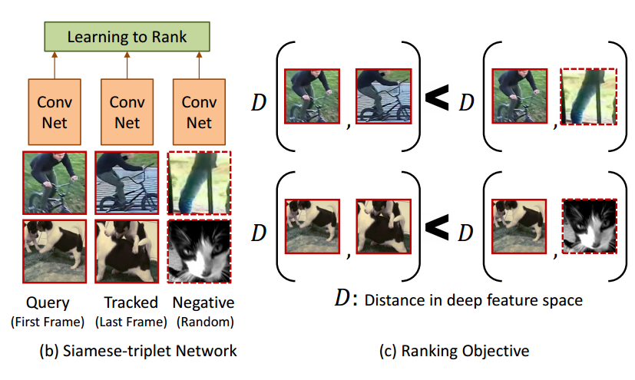
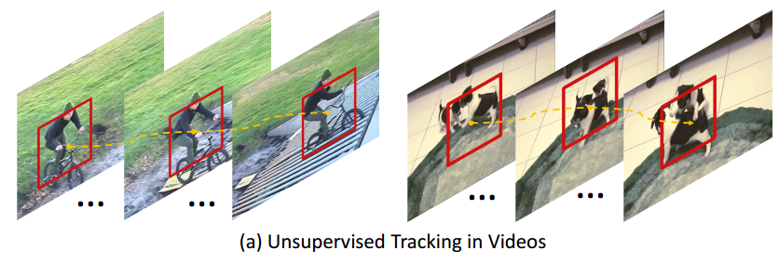
Video
Find corresponding pairs using visual tracking
Wang, X., & Gupta, A. (2015). Unsupervised learning of visual representations using videos. In ICCV2015

Slide 23
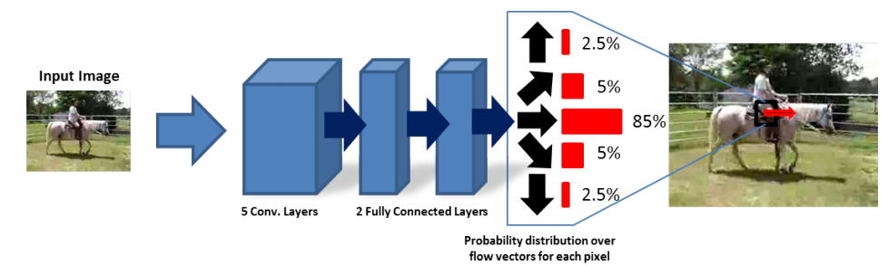
Video
Directly predict motion
Motion is not predictable by its nature
The ultimate goal is not to predict instance motion, but to learn common motion of visually similar objects
Walker, J., Gupta, A., & Hebert, M. Dense optical flow prediction from a static image. In ICCV 2015

Slide 24
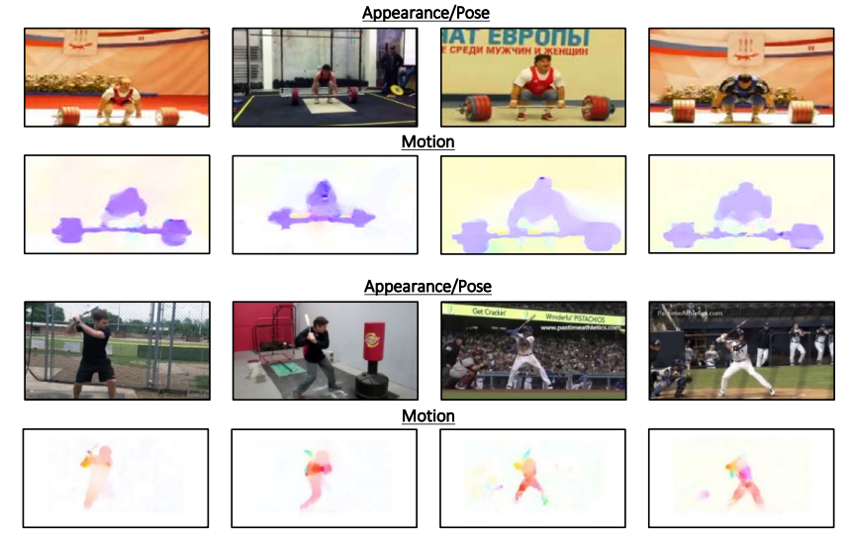
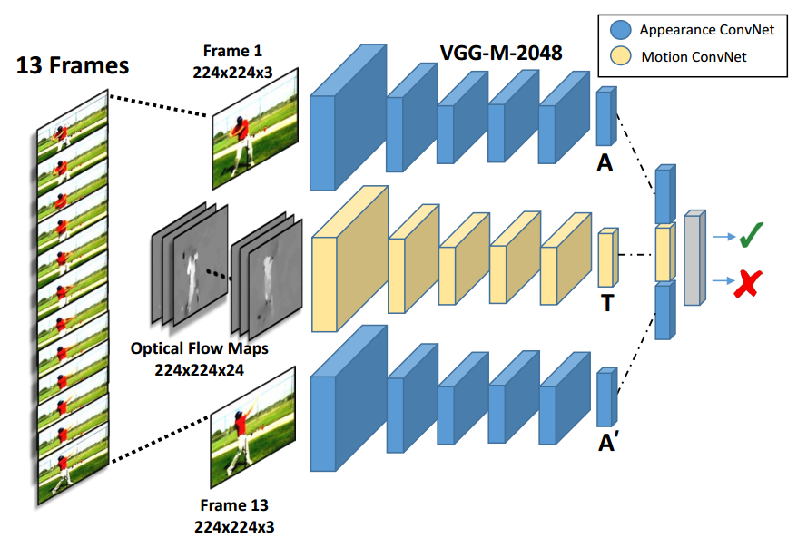
Video
Similar pose should have similar motion
Learning appearance transformation
Purushwalkam, S., & Gupta, A. Pose from Action: Unsupervised Learning of Pose Features based on Motion. In ECCVW 2016.

Slide 25
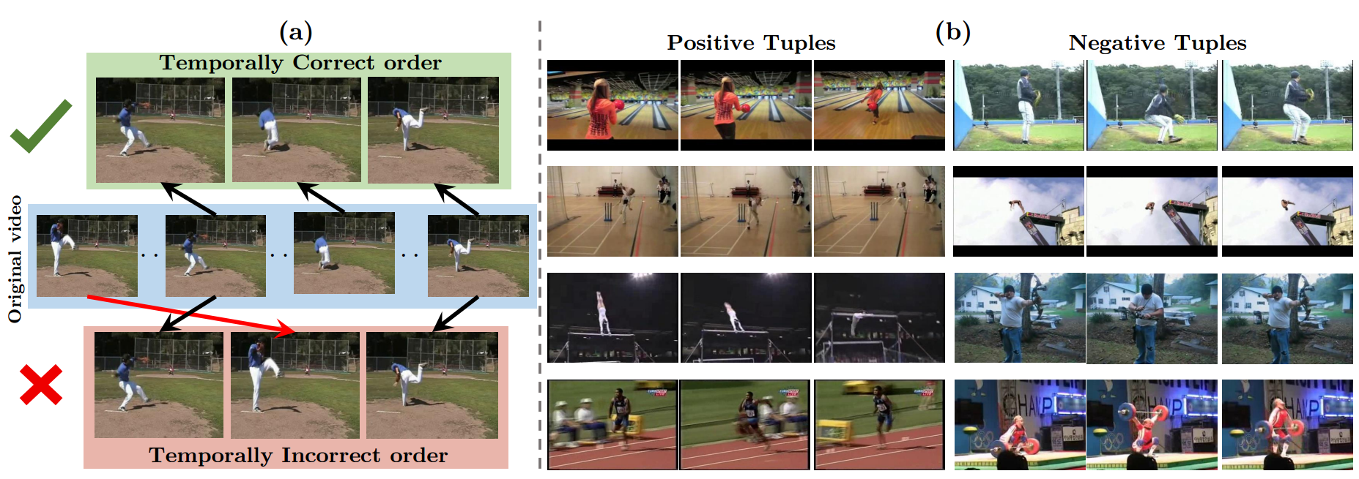
Video
Is the temporal order of a video correct?
Encode the cause and effect of action
Misra, I., Zitnick, C. L., & Hebert, M. Shuffle and learn: unsupervised learning using temporal order verification. In ECCV 2016.

Slide 26
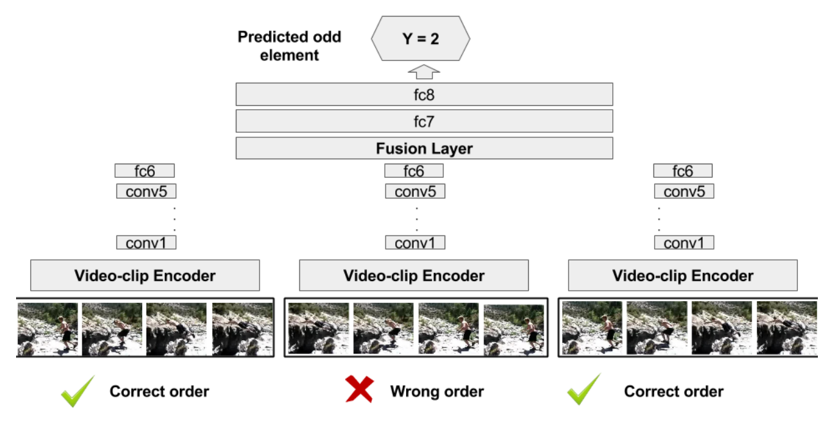
Video
Is the temporal order of a video correct?
Find the odd sequence
Fernando, B., Bilen, H., Gavves, E., & Gould, S. Self-Supervised Video Representation Learning With Odd-One-Out Networks. In CVPR2017.

Slide 27
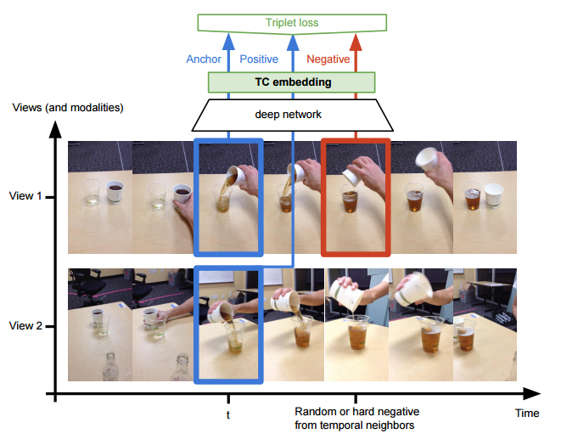
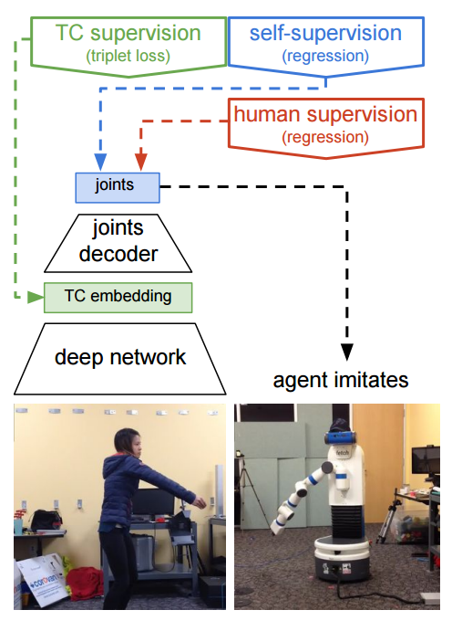
Video
Multi-view
Same action, but different view
View and pose invariant fetures
Sermanet, P., Lynch, C., Hsu, J., & Levine, S. Time-Contrastive Networks: Self-Supervised Learning from Multi-View Observation. arXiv preprint arXiv:1704.06888.

Slide 28
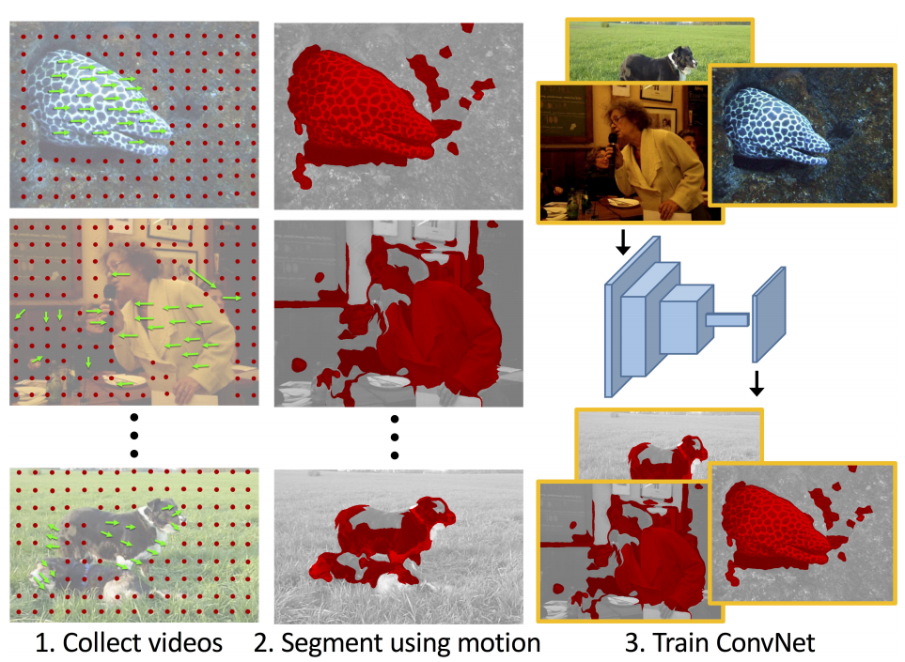
Video
The world is rigid, or at least piecewise rigid
Motion provide evidence of how pixels move together
The pixels move together are likely to form an object
Pathak, D., Girshick, R., Dollár, P., Darrell, T., & Hariharan, B. Learning Features by Watching Objects Move. In CVPR 2017.

Slide 29
Cross-Modality
In some applications, it is easy to collect and align the data from several modalities
Lidar & GPS/IMU & Camera
RGB & D
Image & Text
How to utilize them for cross-supervision?

Slide 30
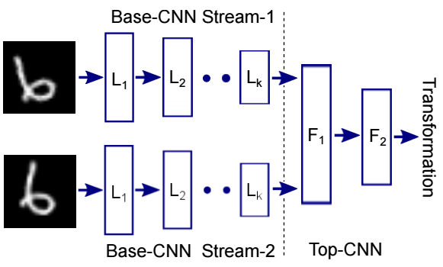
Cross-Modality
Ego-motion
“We move in order to see and we see in order to move” - J.J Gibson
Ego-motion data is easy to collect
Siamese CNN to predict camera translation & Rotation along 3-axises. (Visual Odometry)
Agrawal, P., Carreira, J., & Malik, J. Learning to see by moving. In ICCV 2015

Slide 31
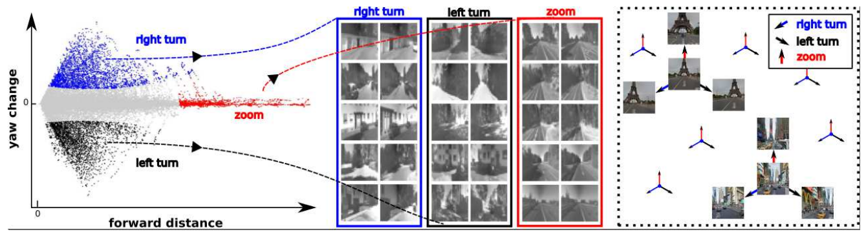
Cross-Modality
Ego-motion
Learning features that are equivariant to ego-motion
Jayaraman, D., & Grauman, K. Learning image representations tied to ego-motion. In ICCV 2015

Slide 32
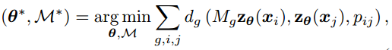

Cross-Modality
Ego-motion
Siamese networks with contrastive loss
M_g is the transformation matrix specified by the external sensors
Jayaraman, D., & Grauman, K. Learning image representations tied to ego-motion. In ICCV 2015

Slide 33
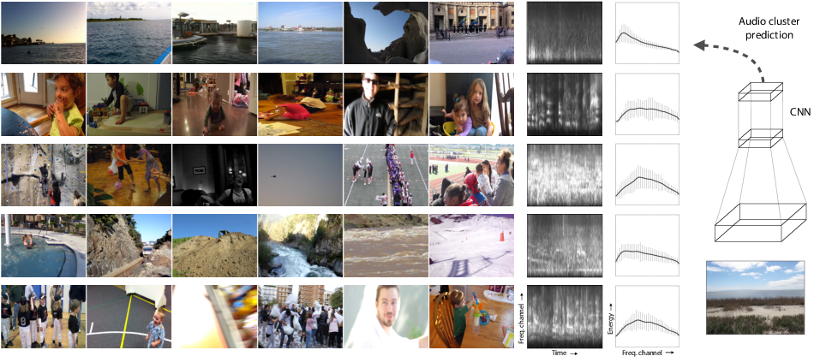
Cross-Modality
Acoustics -> RGB
Similar events should have similar sound.
Naturally cluster the videos.
Owens, A., Wu, J., McDermott, J. H., Freeman, W. T., & Torralba, A. Ambient sound provides supervision for visual learning. In ECCV 2016

Slide 34
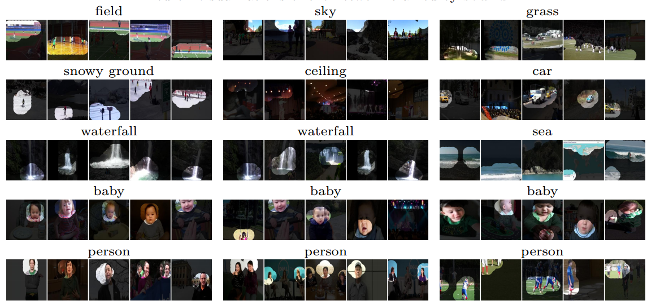
Cross-Modality
Acoustics -> RGB
What does this CNN learn? Separation of baby and person :-D
Owens, A., Wu, J., McDermott, J. H., Freeman, W. T., & Torralba, A. Ambient sound provides supervision for visual learning. In ECCV 2016

Slide 35
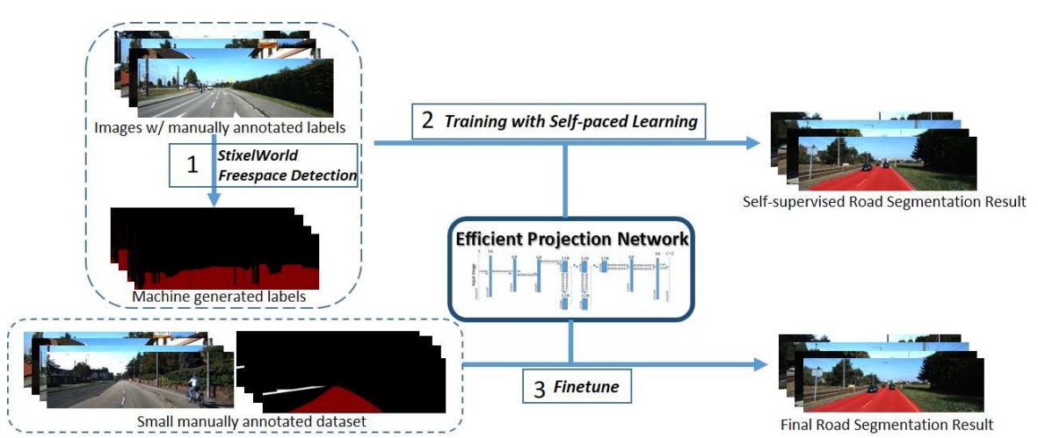
Cross-Modality
Features for road segmentation (Depth -> RGB)
Weiyue W. , Naiyan W. , Xiaomin W. , Suya Y. and Ulrich N. Self-Paced Cross-Modality Transfer Learning for Efficient Road Segmentation. In ICRA2017

Slide 36
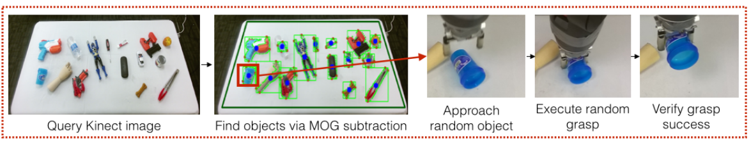
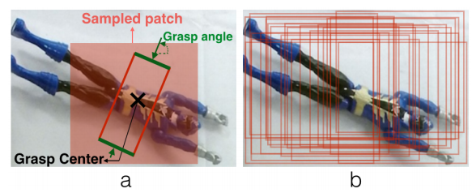
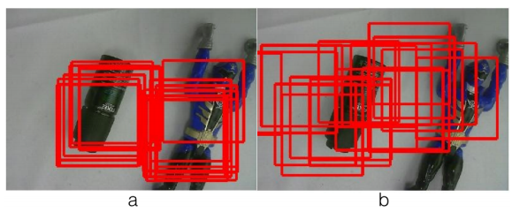
Cross-Modality
Features for grasping
Verify whether we could grasp the center of a patch at a given angle
Pinto, L., & Gupta, A. Supersizing self-supervision: Learning to grasp from 50k tries and 700 robot hours. In ICRA 2016

Slide 37
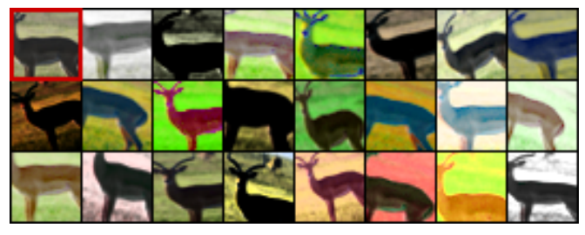
Exemplar Learning
Learning instance features
Each data sample as one class
Need strong augmentation
Dosovitskiy, A., Fischer, P., Springenberg, J. T., Riedmiller, M., & Brox, T. Discriminative unsupervised feature learning with exemplar convolutional neural networks, arXiv preprint. arXiv preprint arXiv:1506.02753.

Slide 38
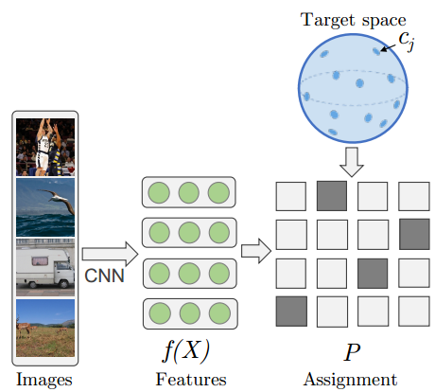
Exemplar Learning
Learning instance features
The key is to avoid trivial solution. (Several tricks in this paper)
Project each sample on a random target uniformly samples on a unit ball
Bojanowski, P., & Joulin, A. Unsupervised Learning by Predicting Noise. arXiv preprint arXiv:1704.05310.

Slide 39
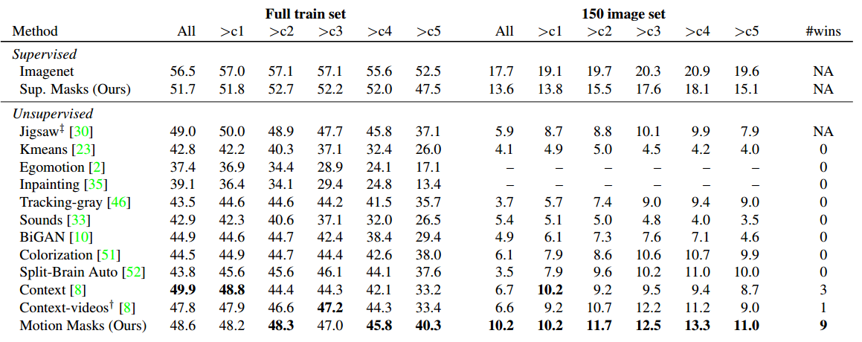
Evaluation
Evaluate on general high-level vision tasks (classification, detection)
Be caution of different settings!
Pathak, D., Girshick, R., Dollár, P., Darrell, T., & Hariharan, B. Learning Features by Watching Objects Move. In CVPR 2017.

Slide 40
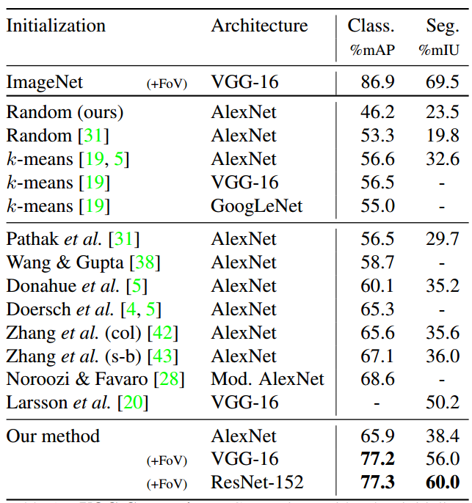
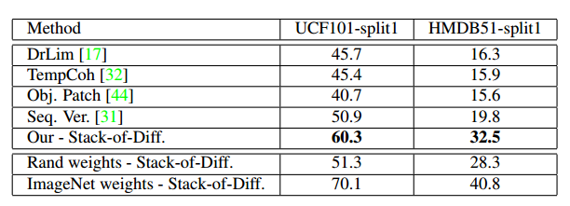
Evaluation
Best so far
Action Recognition

Slide 41
Discussion
How to cross the semantic gap between low-level and high-level?
Utilize high-level/global context
Explore piece-wise rigidity in real-life
More to discover…
What is a useful self-supervised learning?
Improve the performance of subsequent task.
Task Related Self-Supervised Learning

Slide 42

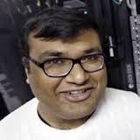
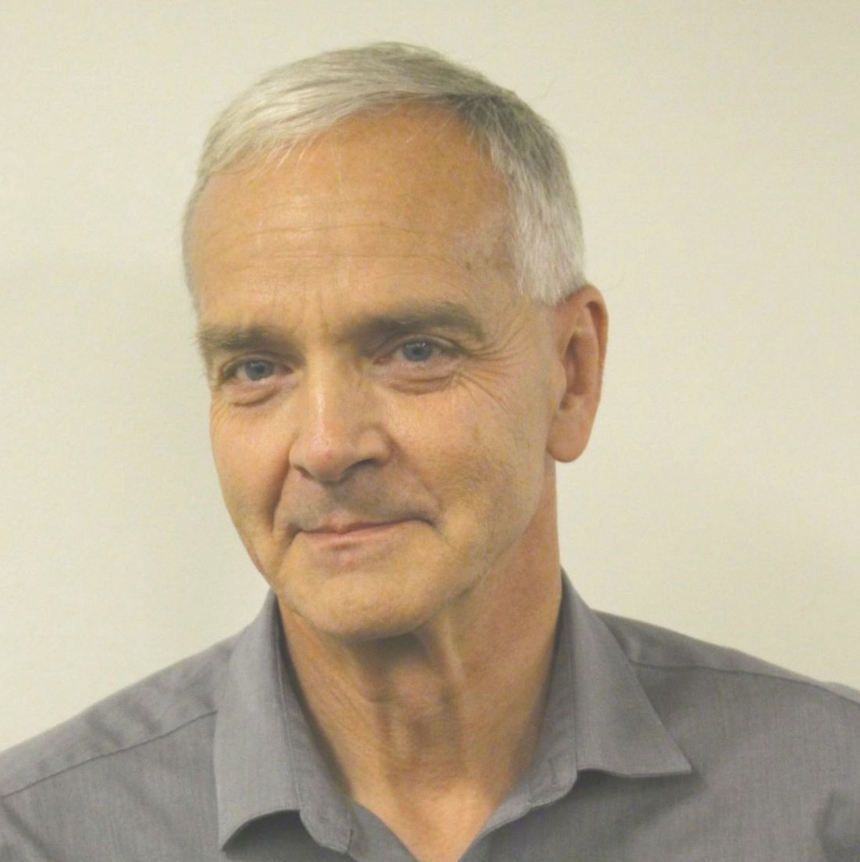
Active Research Groups
Alexei Efros
(Berkeley)
Abhinav Gupta
(CMU)
Martial Hebert
(CMU)

Slide 43
Uncovered Papers
Colorization:
Larsson, G., Maire, M., & Shakhnarovich, G. Learning representations for automatic colorization. In ECCV 2016.
Larsson, G., Maire, M., & Shakhnarovich, G. Colorization as a Proxy Task for Visual Understanding. In CVPR 2017.
Optical Flow
J. J. Yu, A. W. Harley, and K. G. Derpanis. Back to Basics: Unsupervised Learning of Optical Flow via Brightness Constancy and Motion Smoothness. In ECCVW, 2016.
Zhu, Y., Lan, Z., Newsam, S., & Hauptmann, A. G. Guided optical flow learning. arXiv preprint arXiv:1702.02295.
Ren, Z., Yan, J., Ni, B., Liu, B., Yang, X., & Zha, H. Unsupervised Deep Learning for Optical Flow Estimation. In AAAI 2017
Others
Cruz, R. S., Fernando, B., Cherian, A., & Gould, S. DeepPermNet: Visual Permutation Learning. arXiv preprint arXiv:1704.02729.
Nair, A., Chen, D., Agrawal, P., Isola, P., Abbeel, P., Malik, J., & Levine, S. Combining Self-Supervised Learning and Imitation for Vision-Based Rope Manipulation. arXiv preprint arXiv:1703.02018.
Pinto, L., Gandhi, D., Han, Y., Park, Y. L., & Gupta, A. The curious robot: Learning visual representations via physical interactions. In ECCVW 2016.

